Slide 1

Passport Renewal Process for Ghanaians Resident in Canada
Heels & Tech Cohort 7, Group 3
November 2021

Slide 2

OUTLINE
Executive Summary
Stakeholder Analysis
Customer Personas & User Stories
Competitor Analysis (Benchmarking)
Implementation Strategy
Risk Assessment and CBA Analysis
Recommendation
Current- Future State Analysis

Slide 3



Executive Summary
Strategic Objectives
Focus
To provide seamless services for Ghanaian citizens
2. To make Ghana the investment destination of choice
Review of the entire passport renewal processs, identifying barriers and making recommendations for improved processing.
Initiatives
1. To reduce documentation required.
2. To set up an electronic payment channel
3. To set up biometric capture centers to eliminate travel cost
Problem
2 physical locations catering for over 35,000 dispersed population in 12 provinces in Canada. Very inconvenience associated with high cost and long turnaround time

Slide 4
Stakeholder Analysis
Internal Stakeholders
External Stakeholders
Ghanaian Ambassador to Canada
Ghana High Commission / Consulate
Passport Office / Issuing Authority
Consul General
Ghanaian citizens at home
Family of the applicant
Citizens of other countries
Embassies of other countries
Ghanaian government
Legal Team
Canadian Immigration Office
Biometrics/Data capture Officer
Passport booklet printing Vendor
Banks and other financial institutions
Passport Officer
IT Team
Ghanaian applicants in Canada
Guarantor
Witness

Slide 5
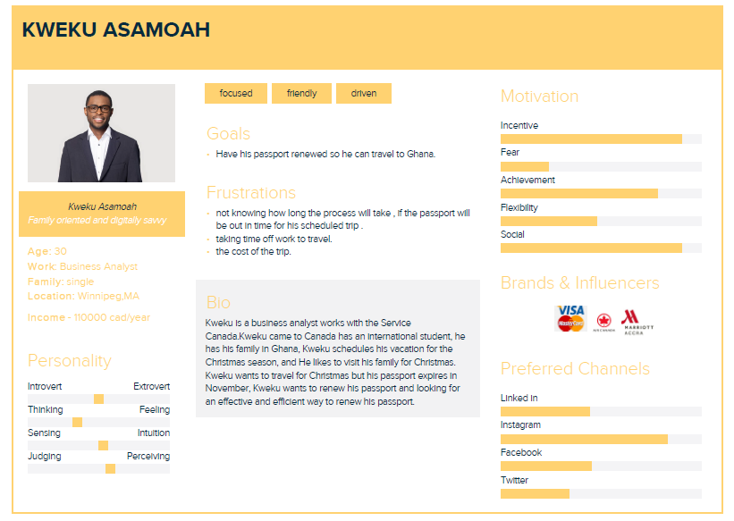
Customer Personas - Applicant

Slide 6
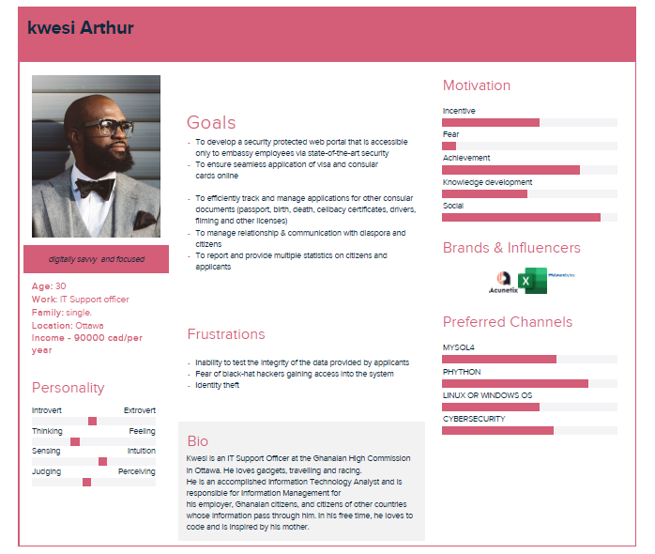
Customer Personas – IT Team

Slide 7
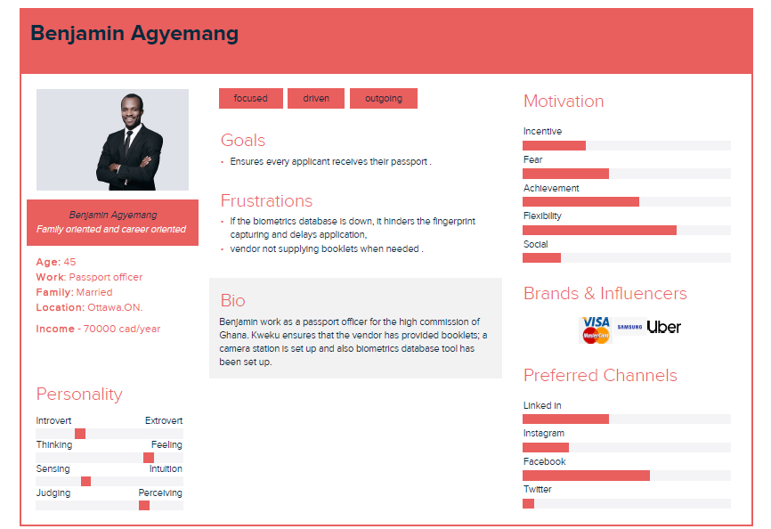
Customer Personas – Passport Officer

Slide 8
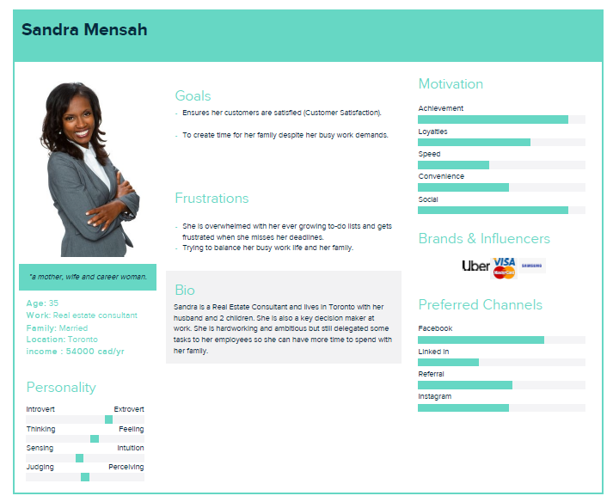
Customer Personas - Witness

Slide 9

Passport Officer Customer Journey Map
Customer Journey Map – Passport Officer
AWARENESS
APPLY
PROCESSING
DECISION
MAINTENANCE
Check an online form submitted by applicant without a discussion with passport officer
Managing paperwork is time consuming and require physical storage
One application process about to be completed
Notify applicant of missing info & document, reject unacceptable docs.
Applicant and guarantor review
If approved, then giving good news is a point of delight
PASSPORT OFFICER
“I leave office at the end of the day knowing my effort and support make certain applicant receive new passport.”
Communicate openly with colleagues
Building good work relationship is satisfying
Fillable data point not submitted to database and can only be enter by the passport officer manually
Get data into the system
Error in application or incomplete application
Checking for fraudulent documents
Passport not mailed due to backlogs
Manual and duplicate data entry
If not approved then the passport has a difficult conservation with applicant
Applicant visit the GHC website, note and provide required info
Helping someone meet an important need
ININCOMPLETE
STATUS CHECK
Obtaining additional info(e.g Biometrics )
Applicant visit the high commission
Initial discussion
Passport officer walks applicant through the application
Helps to prepare and verify the authenticity of documents presented is a source of satisfaction
Application is received; start processing
CCOMPLETE
Recommends approval or denial
Passport approved
Closing process
Passport officer applies new passport mailed to applicant
Check and confirm passport mailed
Confirm passport received
Passport officer responsible for application process
Burden sharing; files sent from high volume officer to those with lower case load
Assessing the passport renewal application
Validate new passport issued
POINT OF DELIGHT
PAIN POINT
EMOTIONAL
LEVEL

Slide 10
User Stories & Acceptance Criteria
I want to make payments using my debit or credit card, to have the flexibility and convenience of fee payment
Select payment and different payment options come up, applicant choose debit or credit payment method
Payment is made and received by the high commission
Navigate the website and fills in application
Put in card details

Slide 11
User Stories & Acceptance Criteria
I want to do my biometrics at the nearest location to me so that I can save cost and travel time
Select the nearest one close to them and book an appointment
A list of fingerprint centers nearest to applicant show up
Navigate the website
Select Biometrics option and put in postal code

Slide 12
Benchmarking – Option Analysis
S/N | Parameter | Best Case Scenario | Base Case Scenario | Worst Case Scenario
 |  | United Kingdom | United States of America | Nigeria
1 | Mode of application | Processed online | By mail | Application is done online and submitted at the High Commission
2 | Rollover of unused period on old passport | At renewal, the time left on the existing passport is added to the new one, up to a maximum of 9 months. | Not applicable | A reason for renewal must be given if your passport is still valid for more than six (6) months.
3 | Passport renewal processing time | +/- 3–4 weeks or sooner | 4-6 weeks by mail | 72 hours - a month
4 | Delivery of renewed passport | The new passport will be sent to you by courier or Royal Mail | The passport will be delivered to the Canadian mailing address provided on the DS-82 form via First Class Mail | Notification via text or email to visit the Chancery to collect the new passport

Slide 13
Implementation Strategy
1
Project Phase
01
To cover the electronic payment system, secure partnerships for biometric capturing and extension of passport validity to 10 years. All internal and representatives of external stakeholders to be selected.
2
Project Planning
02
Estimate project budget- administrative, staffing, collaboration/partnership cost, engineering team
Gather resources- manpower, money, machine
Set up workflow documentation tools
3
03
Project Execution
Team briefing- focus on problems, solutions and expectations.
Manage budget- prudency and disbursement
Monitoring and controlling- quality assurance
4
04
Project Governance
Project board- senior user, project director, project owner
Project team- scum master, scribe, external consultants
05
5
Advisory/Feedback
Strategic advisory group
Stakeholder working group.

Slide 14
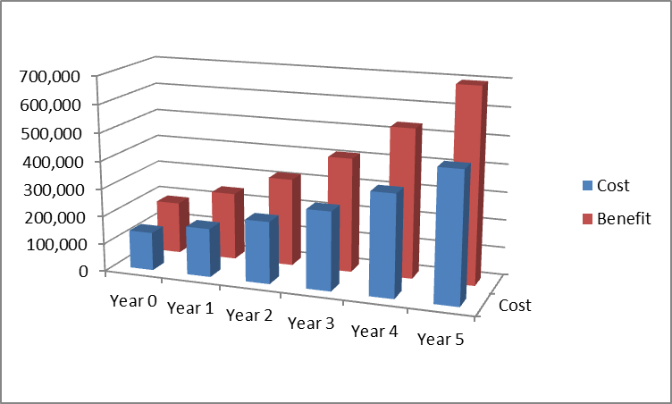
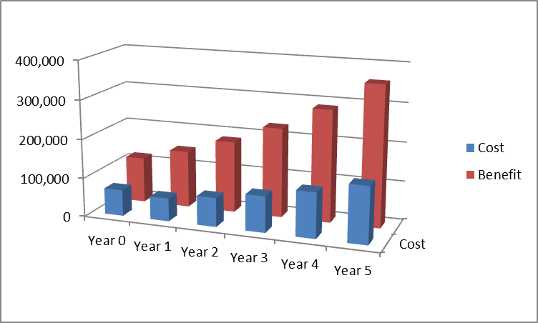
Risk Assessment and CBA Analysis
Alternative 1: Migrating the passport renewal application process including biometrics and passport photography fully online.
Total Cost- $1,647,225
Total Benefit- $2,391,756
Alternative 2 – Provision of evidence of Ghanaian citizenship only rather than also attaching completed form witnessed and stamped by an upstanding Ghanaian national
Total Cost- $554,794
Total Benefit- $1,322,908

Slide 15

Recommendations
Improved Payment Method
Different payment methods, such as debit and credit cards, internet payments, money orders, and bank drafts, should be made available. Applicant may fill out the application and make payment from the comfort of their own home-high convenience level.
Biometrics Centres
We will accept biometrics obtained at a nearby police station, fingerprinting facility, or notary public office, so applicants will not have to travel long distances to renew their passports, saving money and time while providing a high degree of comfort.
Verified Photographers
Make it possible to verify registered photographers who can take images of clients and passport photos. To reduce danger, the agency will only accept images from Pro passports with the photographer's information stamped on the back of the passport, which the institution can readily check - convenience level high.

Slide 16










Current to Future State Analysis
Item | Alternative Options | Impact on Stakeholder Experience
Long form/Documentation | Use of information in Biometric form | 50% increase in rate of form completion
Payment | Use of credit/debit card Online transfer option | Payment turnaround time reduced to 5mins.
Fulfilment | Use of courier or Royal mail | 70% in cost reduction and 80% reduction in turnaround time

Slide 17
Thank you!

